Slide 1
2 C
AFTER 300 METRES, TURN RIGHT

Slide 2
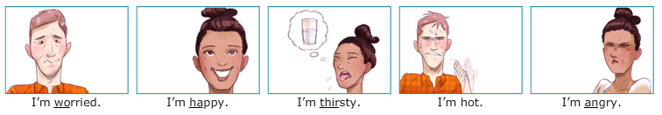


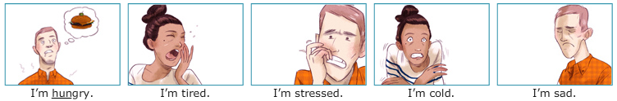
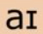
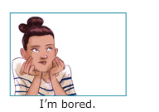

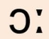
BE + Feelings

Slide 3
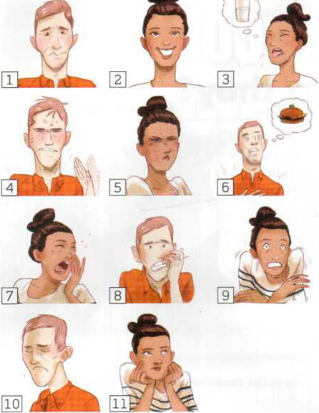
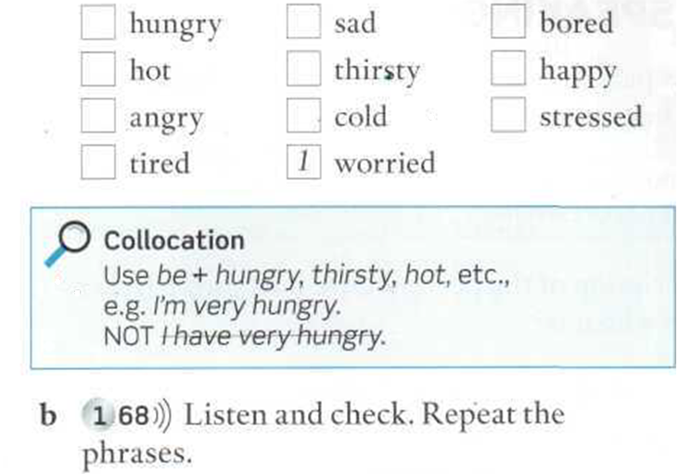
Memorize the phrases and say them in relation to all the pictures.

Slide 4
VOCABULARY: feelings
WB 15
Write a sentence from the box.
I´m angry; I'm bored. I'm cold. I'm happy. I'm hot. I'm hungry. I'm sad. I'm stressed. I'm tired. I'm thirsty. I'm worried.
My friend is late. _________________________.
It's 3°C. _________________________________
It's my birthday! __________________________
My mother is in hospital. ________________________
It's time for dinner. ____________________________
I don't know what to do. ________________________
It's 42°C. ___________________________________
It's very late. ____________________________
My boyfriend is very far away. ____________________
I want a drink. ____________________________
I have a lot of work. ____________________________

Slide 5
1
THE CARTER FAMILY
4
2
On holiday in Ireland
5
3
6

Slide 6
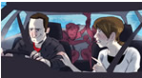

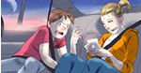
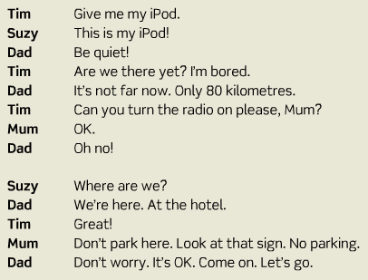
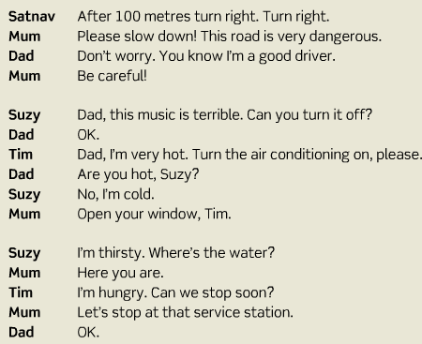
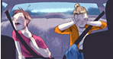
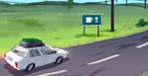
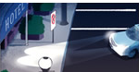

Slide 7
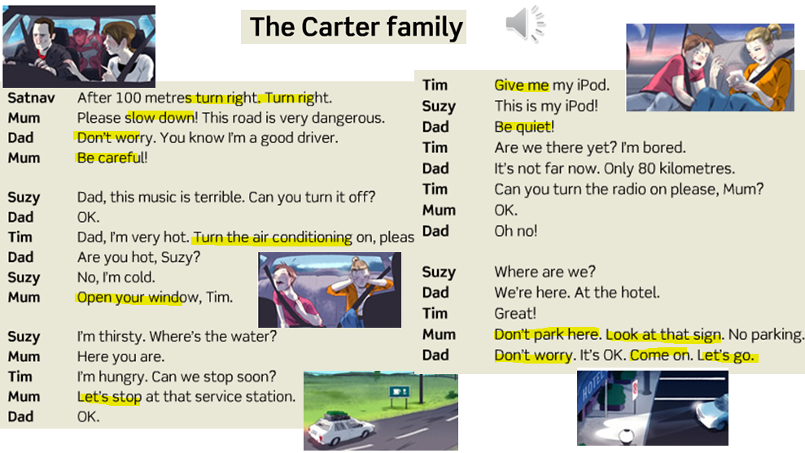

Slide 8
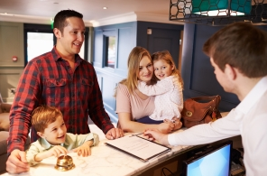
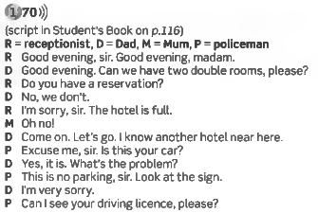
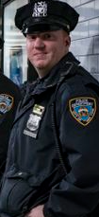

THE CARTER FAMILY
On holiday in Ireland

Slide 9
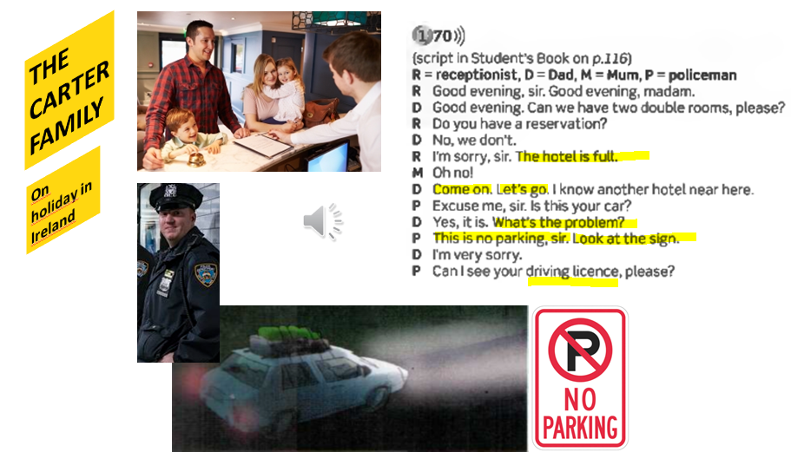

Slide 10
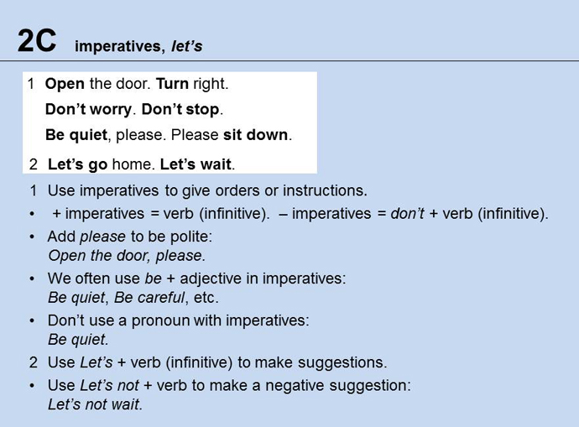
Mention some classroom instructions (1C)

Slide 11
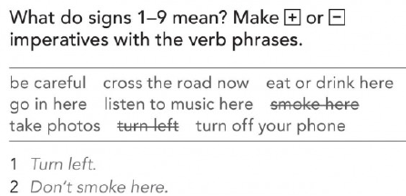
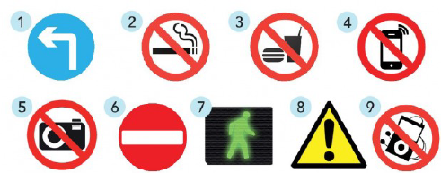
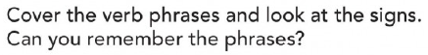
PAGE 17
Don’t smoke here
Don’t eat or drink here
Turn off your phone
Turn left
Don’t take photos
Don’t go in
Cross the road now
Be careful
Don’t listen to music here

Slide 12
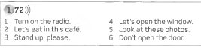
Dictation:
Write the imperatives you hear.

Slide 13
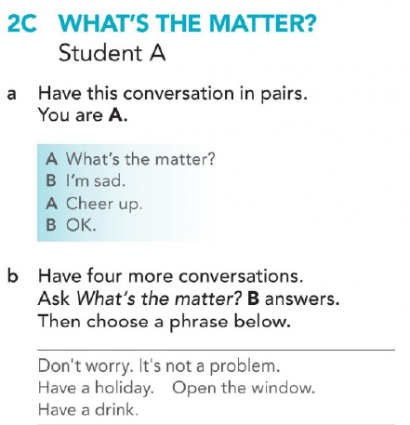
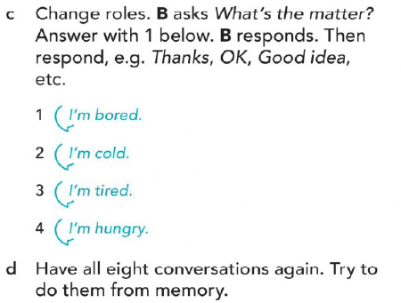
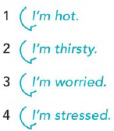
Role play the dialogues at pages 101, 106
Memorize all eight conversations
Don´t be sad.
Cheer up.

Slide 14
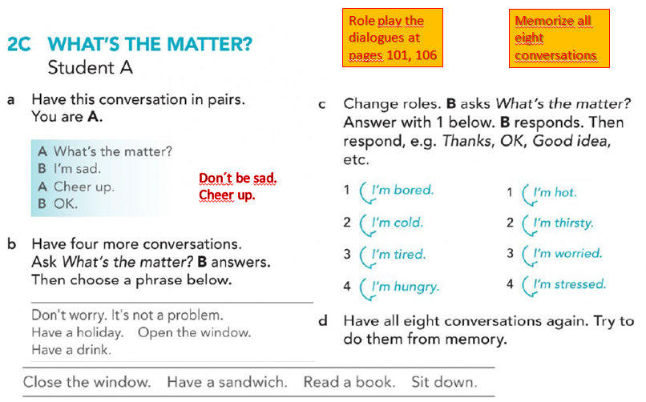

Slide 15



IMPERATIVES
WORKBOOK Page 15
Complete the sentences with a verb in the box. Use a positive or a negative imperative.
be close come drink park slow speak turn worry
1 The city is dangerous at night. Please _______ careful.
2 It's cold in here. Please __________ the window.
3 It isn't a problem. Please, _____________ about it.
4 This is an English class. Please___________ Spanish.
5 Their house is quite near. Please __________ down.
6 ___________on! We're late!
7 This is a bus stop. Please ______________ here.
8 _______________that water - it's dirty.
9 This music is terrible. Please _____________ it off.
don’t worry
don’t speak
don’t park
don’t drink

Slide 16
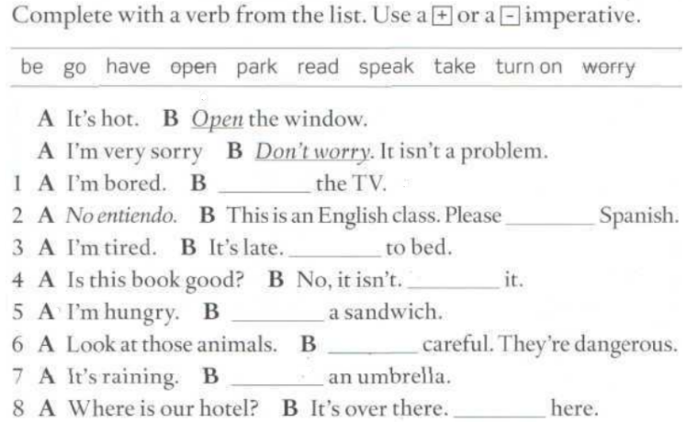
Page 127
Turn on
Don´t speak
Go
Don´t read
Have
Be
Take
Park

Slide 17
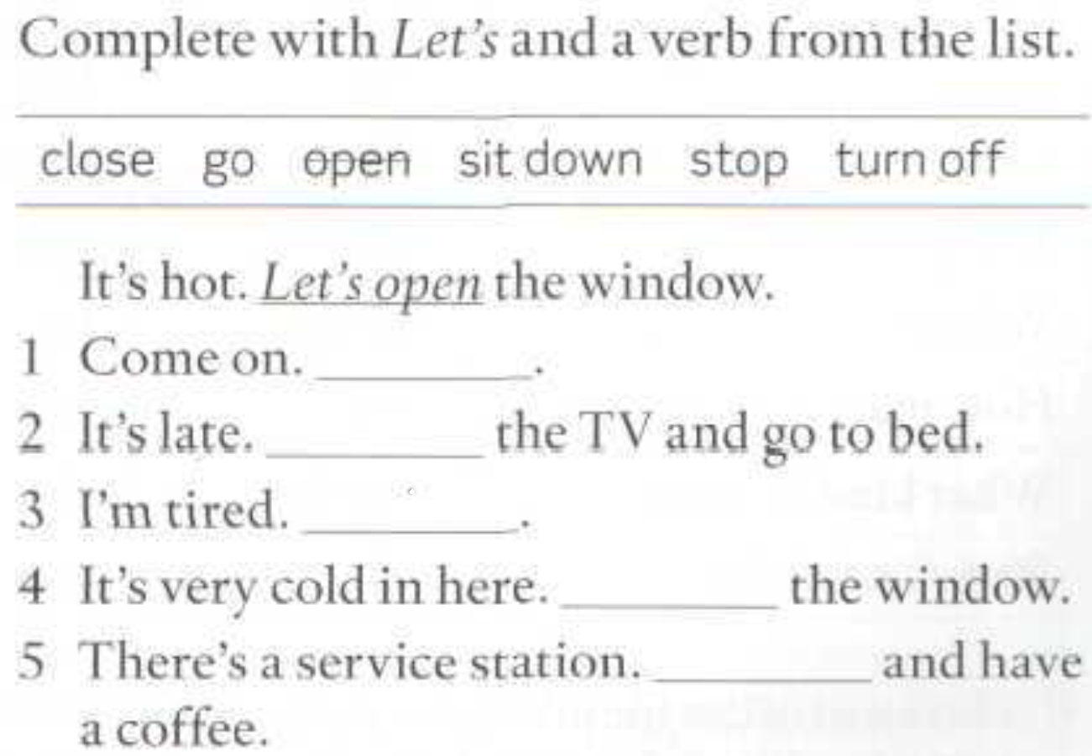
Page 127
Let’s go
Let’s turn off
Let’s sit down
Let’s close
Let’s stop

